Slide 1
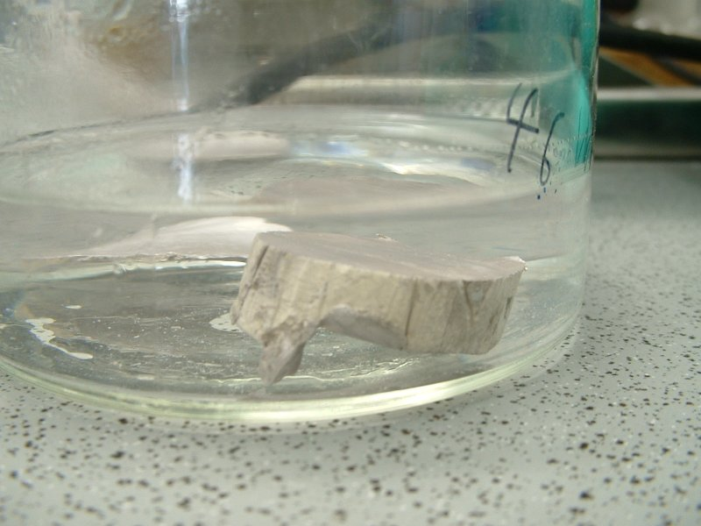
ELEMENT CLASSES

Slide 2
CA Standards
Students know how to use the periodic table to identify alkali metals, alkaline earth metals, transition metals, metals, semimetals (metalloids), nonmetals, halogens and noble gases.

Slide 3
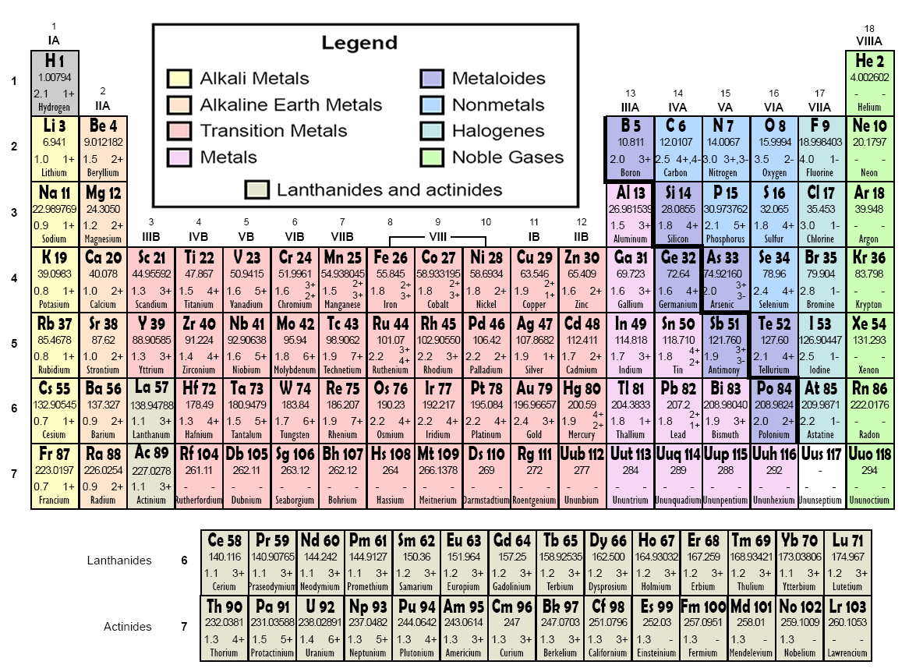

Slide 4

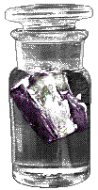
Alkali Metals
All alkali metals have 1 valence electron
Alkali metals are NEVER found pure in nature; they are too reactive
Reactivity of these elements increases down the group
Potassium, K reacts with water and must be stored in kerosene

Slide 5

Alkaline Earth Metals
All alkaline earth metals have 2 valence electrons
Alkaline earth metals are less reactive than alkali metals
Alkaline earth metals are not found pure in nature; they are too reactive
The word “alkaline” means “basic”
  common bases include salts of the metals
    Ca(OH)₂
    Mg(OH)₂

Slide 6
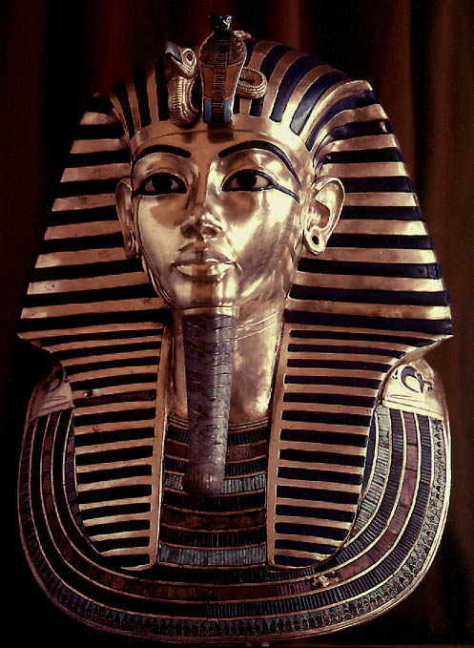
Properties of Metals
Metals are good conductors of heat and electricity
Metals are malleable
Metals are ductile
Metals have high tensile strength
Metals have luster

Slide 7
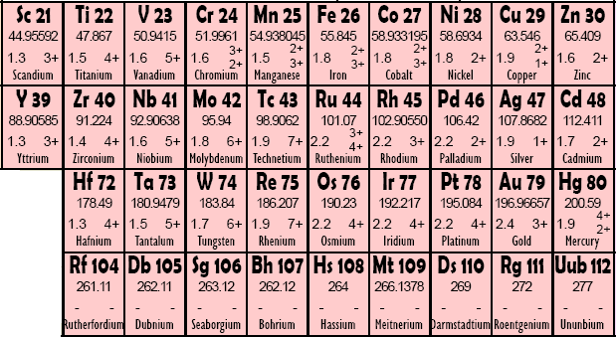
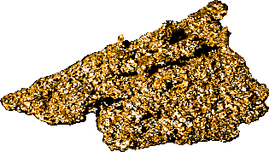
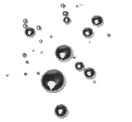
Transition
Metals
Copper, Cu, is a relatively soft metal, and a very good electrical conductor.
Mercury, Hg, is the only metal that exists as a liquid at room temperature

Slide 8
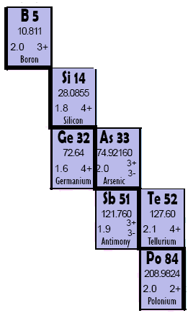
Properties of
Metalloids
They have properties of both metals and nonmetals.
Metalloids are more brittle than metals, less brittle than most nonmetallic solids
Metalloids are semiconductors of electricity
Some metalloids possess metallic luster

Slide 9
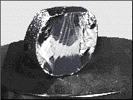
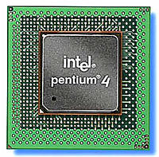
Silicon, Si – A Metalloid
Silicon has metallic luster
Silicon is brittle like a nonmetal
Silicon is a semiconductor of electricity
Other metalloids include:
Boron, B
Germanium, Ge
Arsenic, As
Antimony, Sb
Tellurium, Te

Slide 10
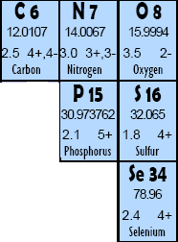
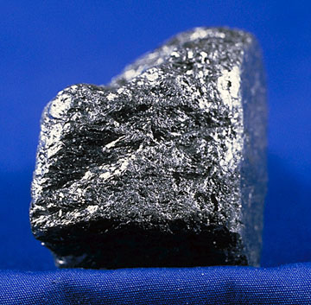
Nonmetals
Nonmetals are poor conductors of heat and electricity
Nonmetals tend to be brittle
Many nonmetals are gases at room temperature
Carbon, the graphite in “pencil lead” is a great example of a nonmetallic element.

Slide 11
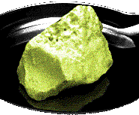
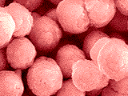
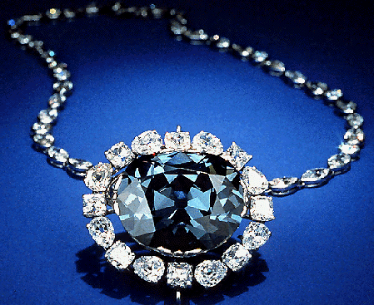
Examples of Nonmetals
Microspheres of phosphorus, P, a reactive nonmetal
Sulfur, S, was once known as “brimstone”
Graphite is not the only pure form of carbon, C. Diamond is also carbon; the color comes from impurities caught within the crystal structure

Slide 12

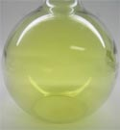
Halogens
Halogens all have 7 valence electrons
Halogens are never found pure in nature; they are too reactive
Halogens in their pure form are diatomic molecules (F₂, Cl₂, Br₂, and I₂)
Chlorine is a yellow-green poisonous gas

Slide 13

Noble Gases
Noble gases have 8 valence electrons (except helium, which has only 2)
Noble gases are ONLY found pure in nature – they are chemically unreactive
Colorless, odorless and unreactive; they were among the last of the natural elements to be discovered

